Slide 1
Objective-C

Slide 2


Creating Objects
Or, all in one line
Returns a Party
Operates on a Party

Slide 3
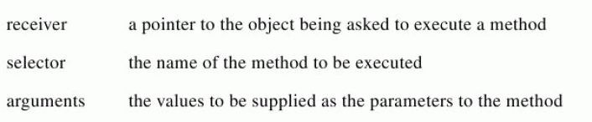
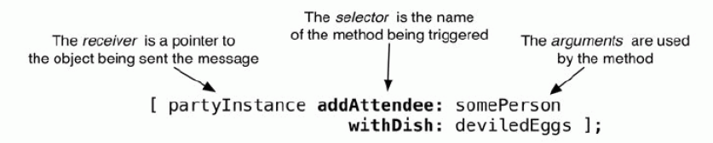
Messaging Objects

Slide 4
Defining Messages
In C++
(returnType) functionName((argType1)argName1, (argType2)argName2) {}
In Objective-C
-(returnType) selector1:(argType1)argName1 selector2:(argType2)argName2
{}

Slide 5
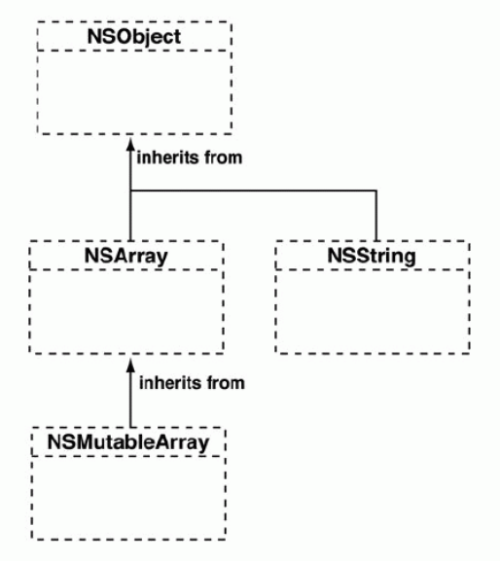
Class Hierarchy
Example: From NSObject to NSMutableArray
Mutable = changeable
Note: some methods have ‘:’ – this means they require arguments!
alloc
init
description
objectAtIndex:
count
length
addObject:
insertObject: AtIndex:
removeObject:

Slide 6

Fast Enumeration
Can be used for accessing elements in an Array
Create NSString called item
items is Array of NSStrings
NSString Formatting
- @“ ” … This is a NSString
- @“ %x ” … This creates 1 NSString from >1 object
^the token is the type of variable to format
- @“%f”, 3.0 … Turn a float (value 3) into a NSString

Slide 7
Encapsulation with properties
Create using the @property keyword
  Note: now auto-synthesized
Getters and Setters for the property is automatically created
Example: create a date property within the Party class
  @property NSDate partyDay;
Now an instance of the party can have its date accessed or set using:
  partyInstance.partyDay; // getter
  [partyInstance setPartyDay:[[NSDate alloc] init]; //setter
  Note that the ^above line^ is functionally identical to:
  partyInstance.partyDay = [[NSDate alloc] init]; //setter

Slide 8
Overriding Methods
A subclass can override methods of its superclass
E.g., NSObject implements: alloc, init, description
  We use these when we subclass NSObject
We can override these methods to do custom tasks
To do this, all we have to do is define it in the @implementation

Slide 9
Initializing
You may have multiple init-ers, but you will have only one “designated initializer”
  This makes sure a Class is ready to rock’n’roll
  Should always call the superclass’s initializer
  Be sure to update init to call the designated initializer
self: points to the object being created
  In every other language, it is called ‘this’
  Returned from init as a pointer to the new object

Slide 10
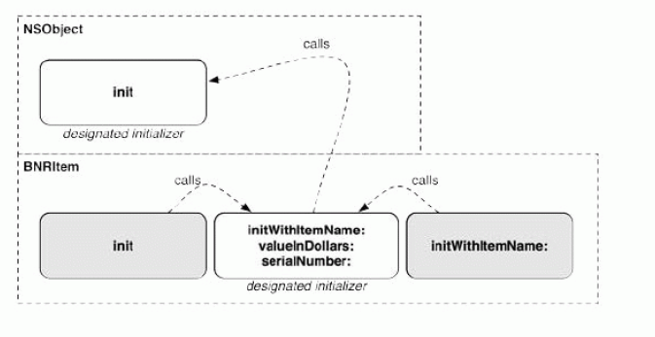
Initialization Chain

